Slide 1
Azure Analysis Services

Slide 2
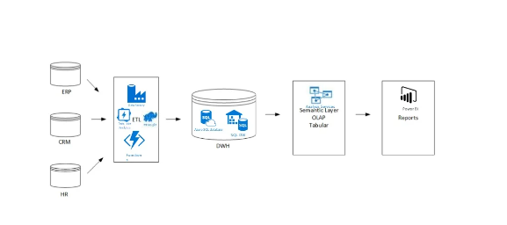
Traditional BI components on Azure

Slide 3
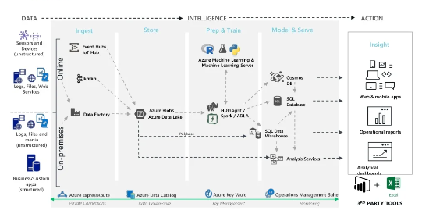
Data Management Solutions

Slide 4
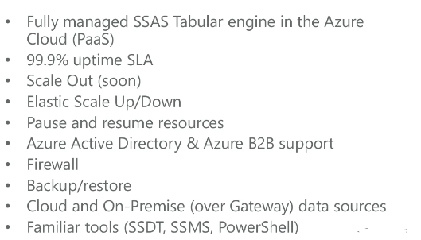
Analysis Services in the Cloud

Slide 5
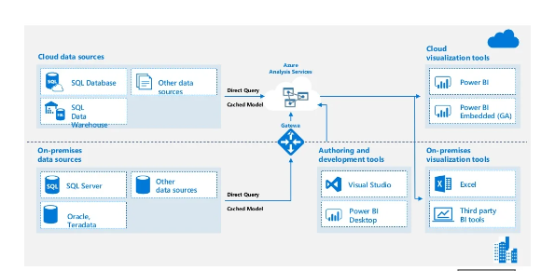
Azure Analysis Services Architecture

Slide 6
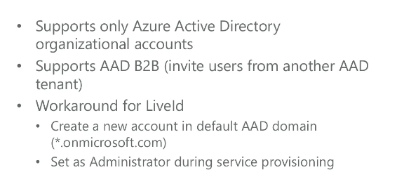
Azure AD Authentication

Slide 7
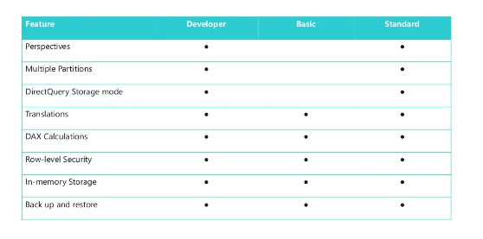
Feature Comparison

Slide 8
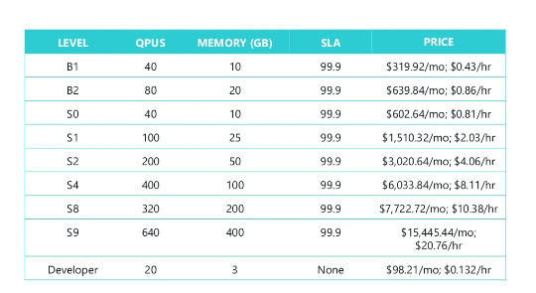
Performance Levels

Slide 9
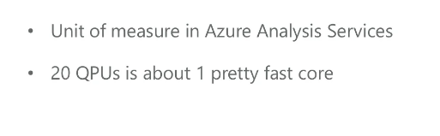
Query Processing Unit

Slide 10
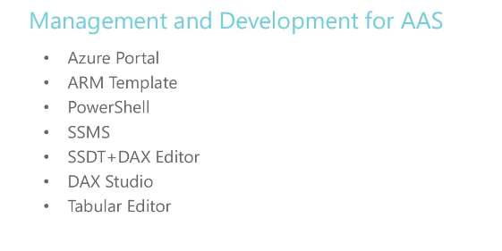
Management & Development of AAS

Slide 11
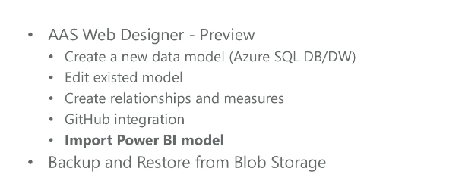
Management & Development of AAS

Slide 12
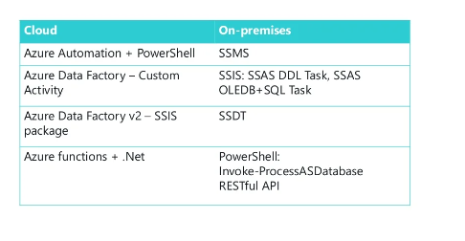
Processing

Slide 13
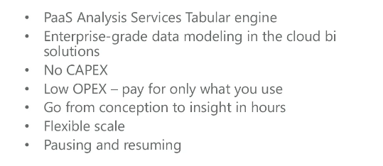
Summary

